Slide 1
Auth token acquisition library
migration ADAL=> MSAL
Shijie Zhang

Slide 2
About me
Infrastructure engineer, ~5y
Enterprise instant messenger product
Our team owns the platform of a stateless monolithic service
Auth & resilience: ~10 types of tokens per day

Slide 3
Outline
Why this migration project?
Background
Motivations
People challenges
Get funding on roadmap
Risk management
Technical challenges
Design shared packages
Debug cache increase issue
Summary

Slide 4
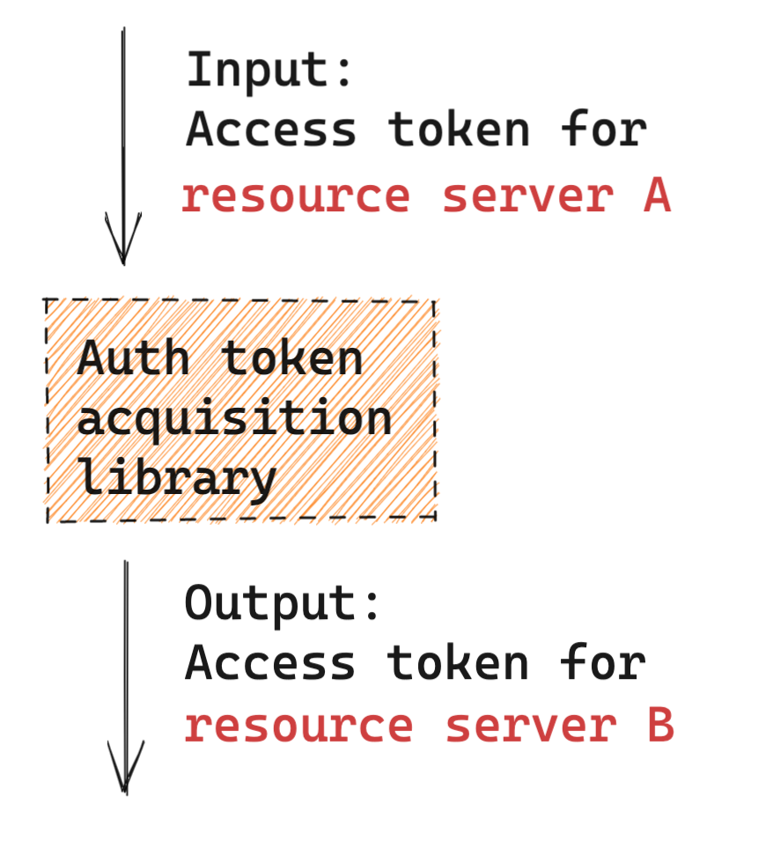
Auth token acquisition library responsibilities
Use scenario:
Critical path
Invoked before calling every downstream service

Slide 5
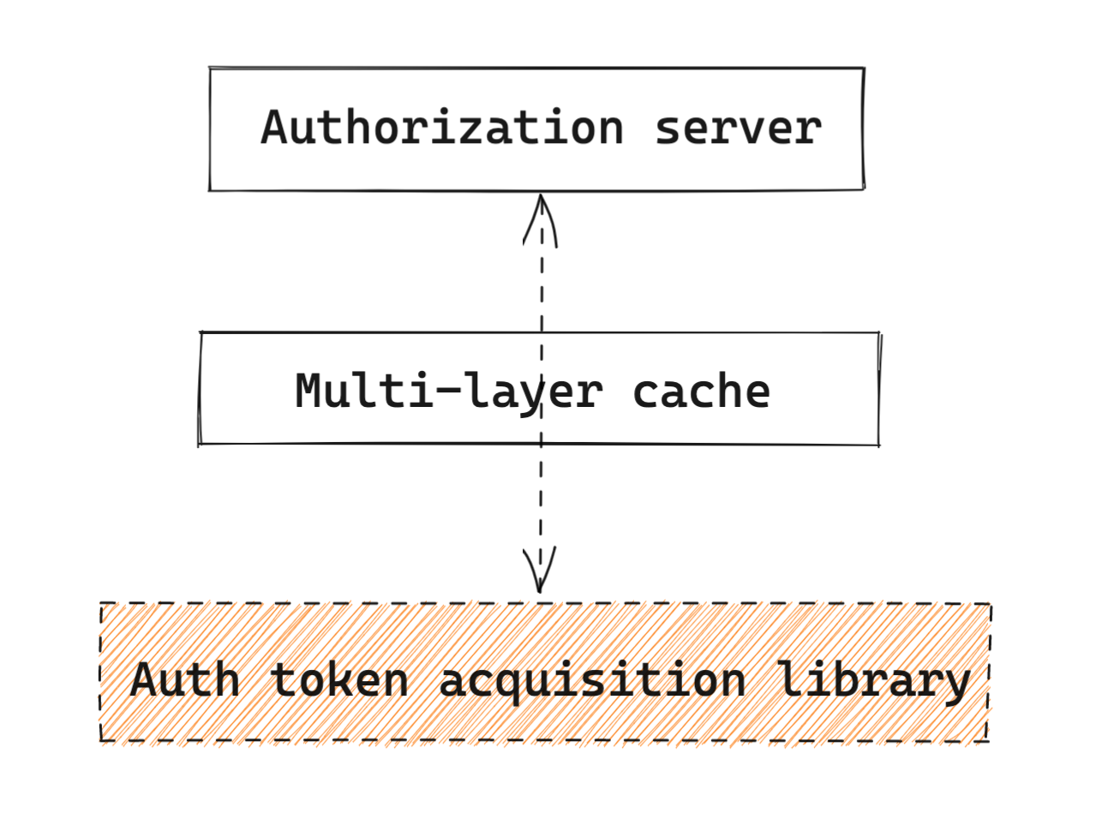
Auth token acquisition library responsibilities
Components:
Authorization server
Multi-layer cache

Slide 6
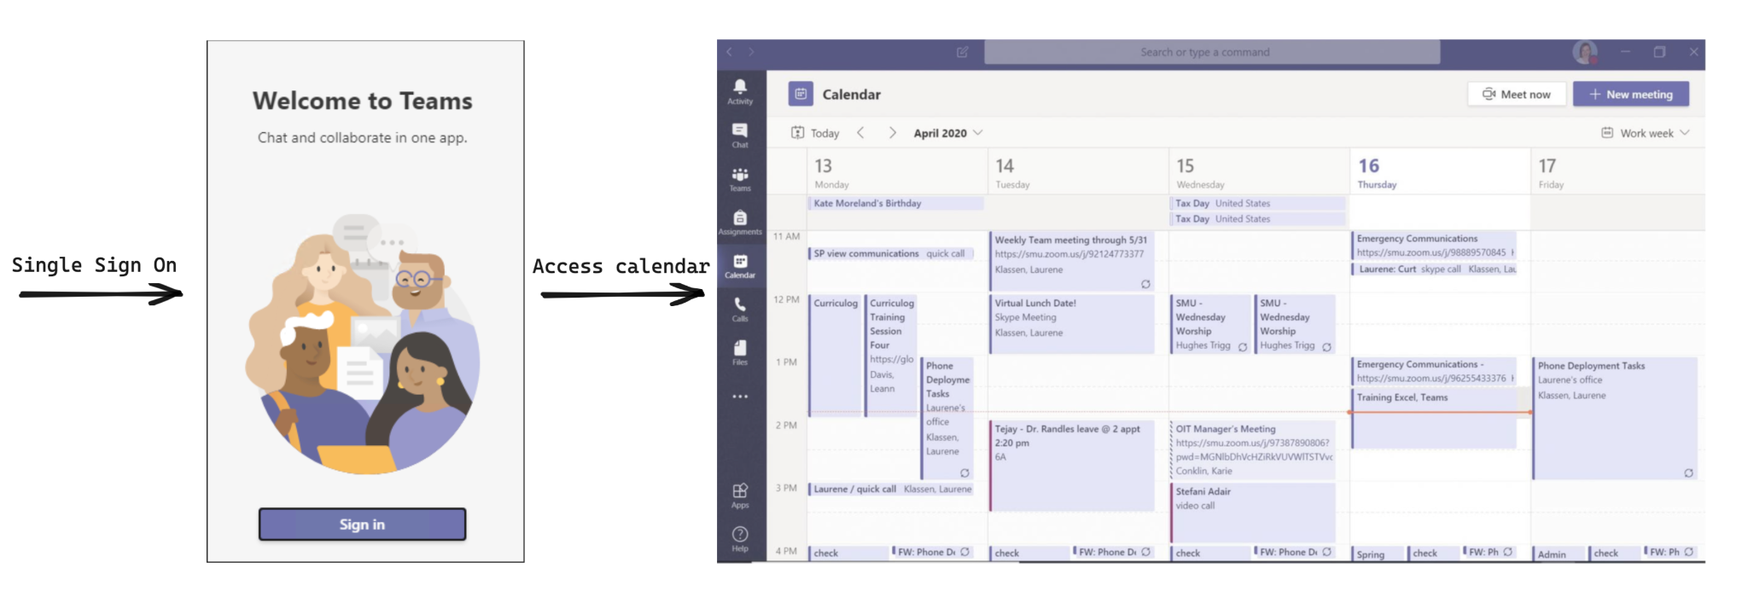
Example: User signs in and accesses calendar

Slide 7
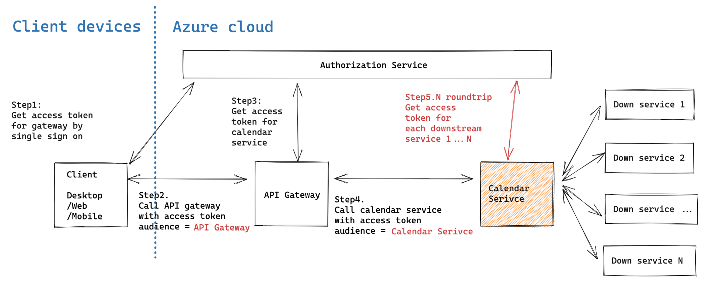
Example: Flowchart behind the scene (OAuth flow)

Slide 8
Motivations for the migration ADAL=>MSAL
Resilience enhancement:
Proactively refresh token in the background 8 hours before expiry
Regional authorization server support instead of single global endpoint
Fallback authorization server support to extend token life from 1D => 3D
Security requirement
ADAL libraries will be deprecating in 6 months

Slide 9
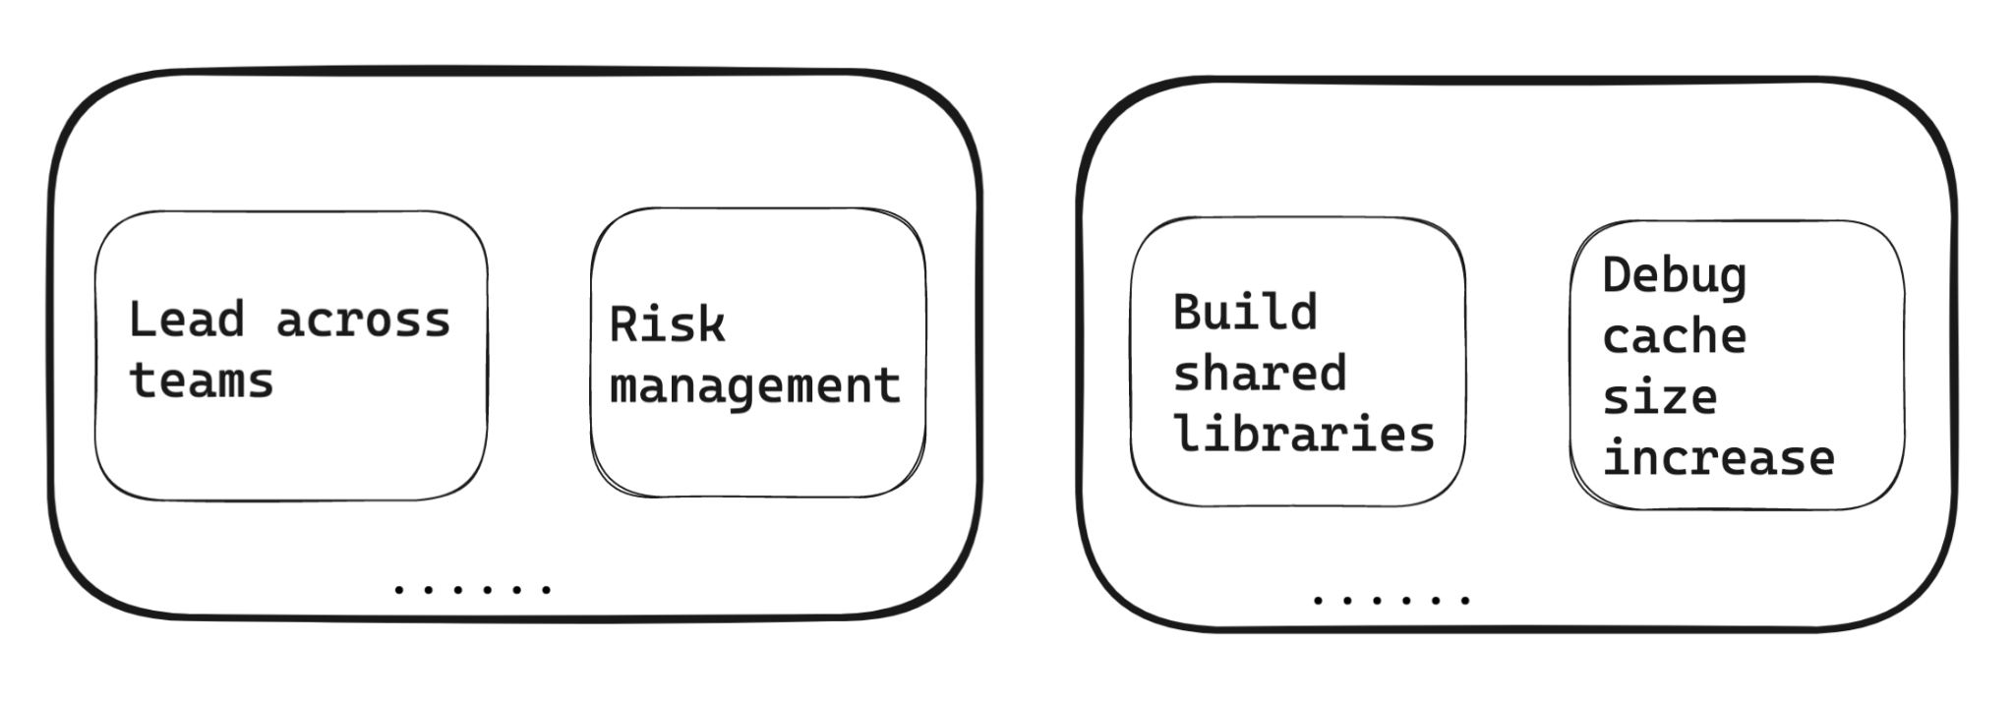
Challenges for the migration
People Challenges
Technical Challenges

Slide 10
Outline
Why this migration project?
Background
Motivations
People challenges
Get funding on roadmap
Risk management
Technical challenges
Design shared packages
Debug cache increase issue
Summary

Slide 11
Outline
Why this migration project?
Background
Motivations
People challenges
Get funding on roadmap
Risk management
Technical challenges
Design shared packages
Debug cache increase issue
Summary

Slide 12
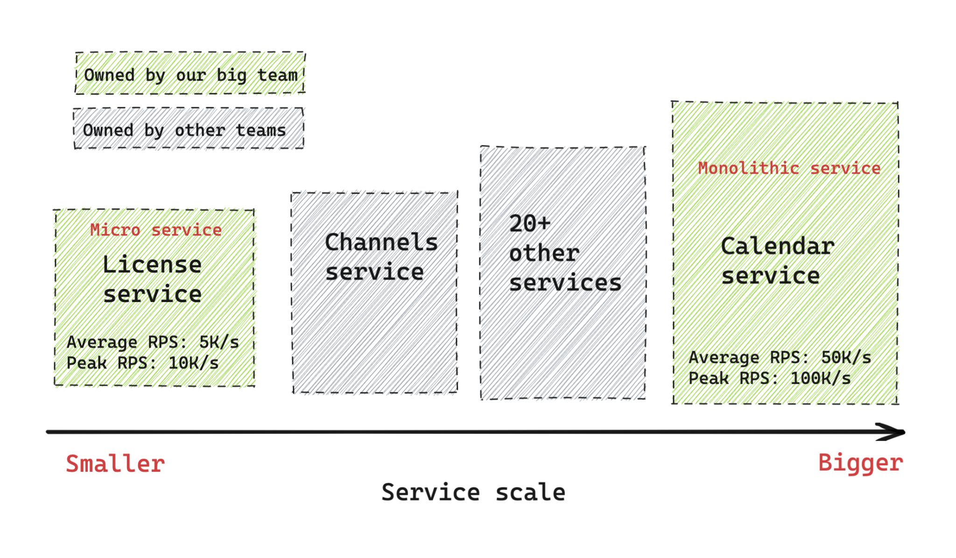
People challenges: Get funding on the roadmap
Project scope:
ADAL => MSAL
Over 20+ service needs migration

Slide 13
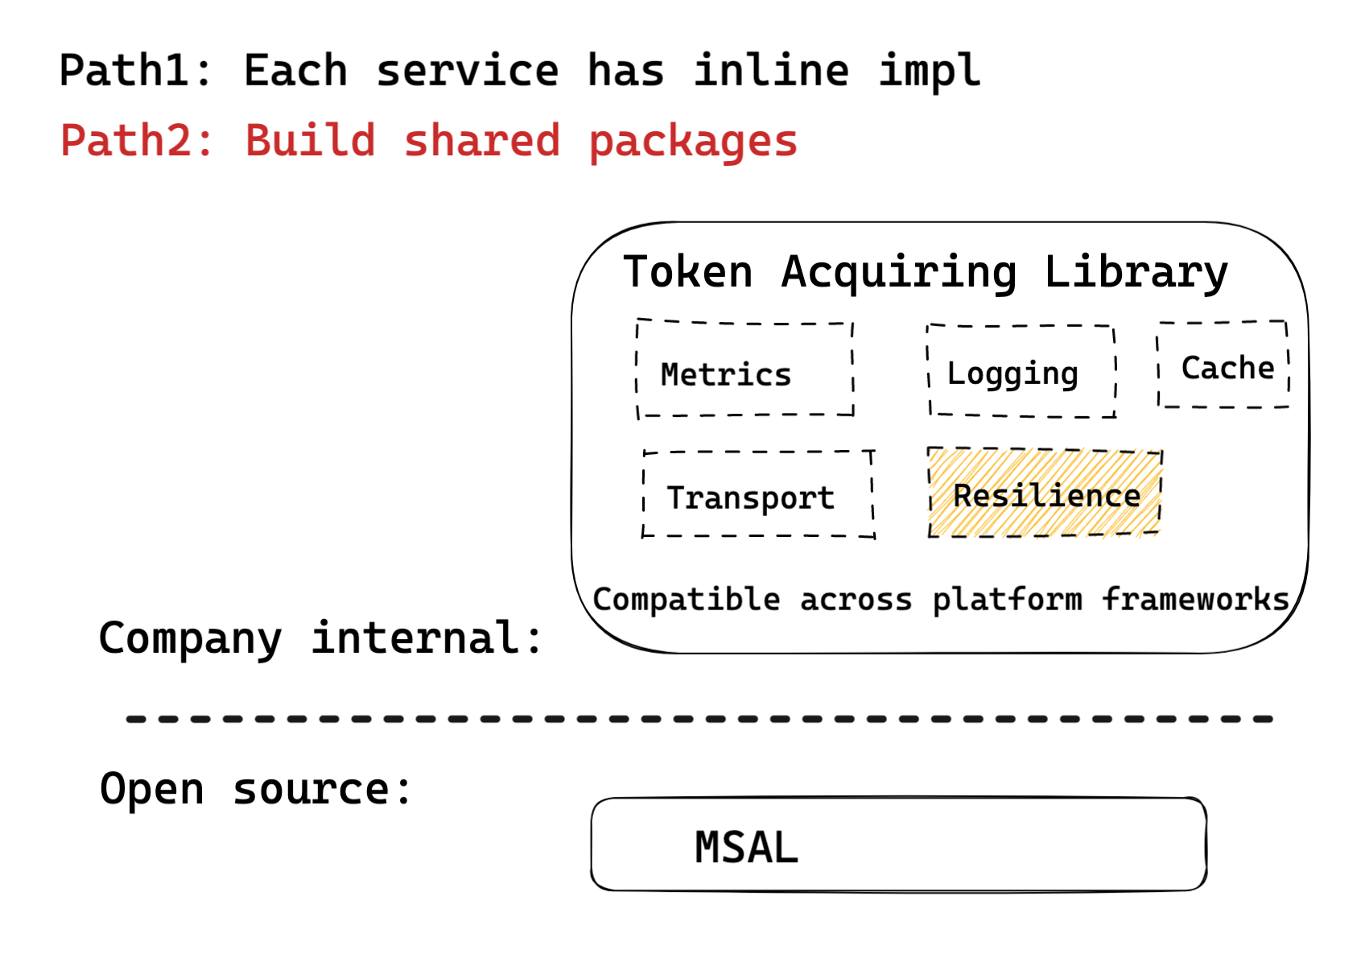
People challenges: Get funding on the roadmap
Get funding for
Favoring reusability vs short-time speed
Top priority for the team
Two additional devs

Slide 14
Outline
Why this migration project?
Background
Motivations
People challenges
Get funding on roadmap
Risk management
Technical challenges
Design shared packages
Debug cache increase issue
Summary

Slide 15
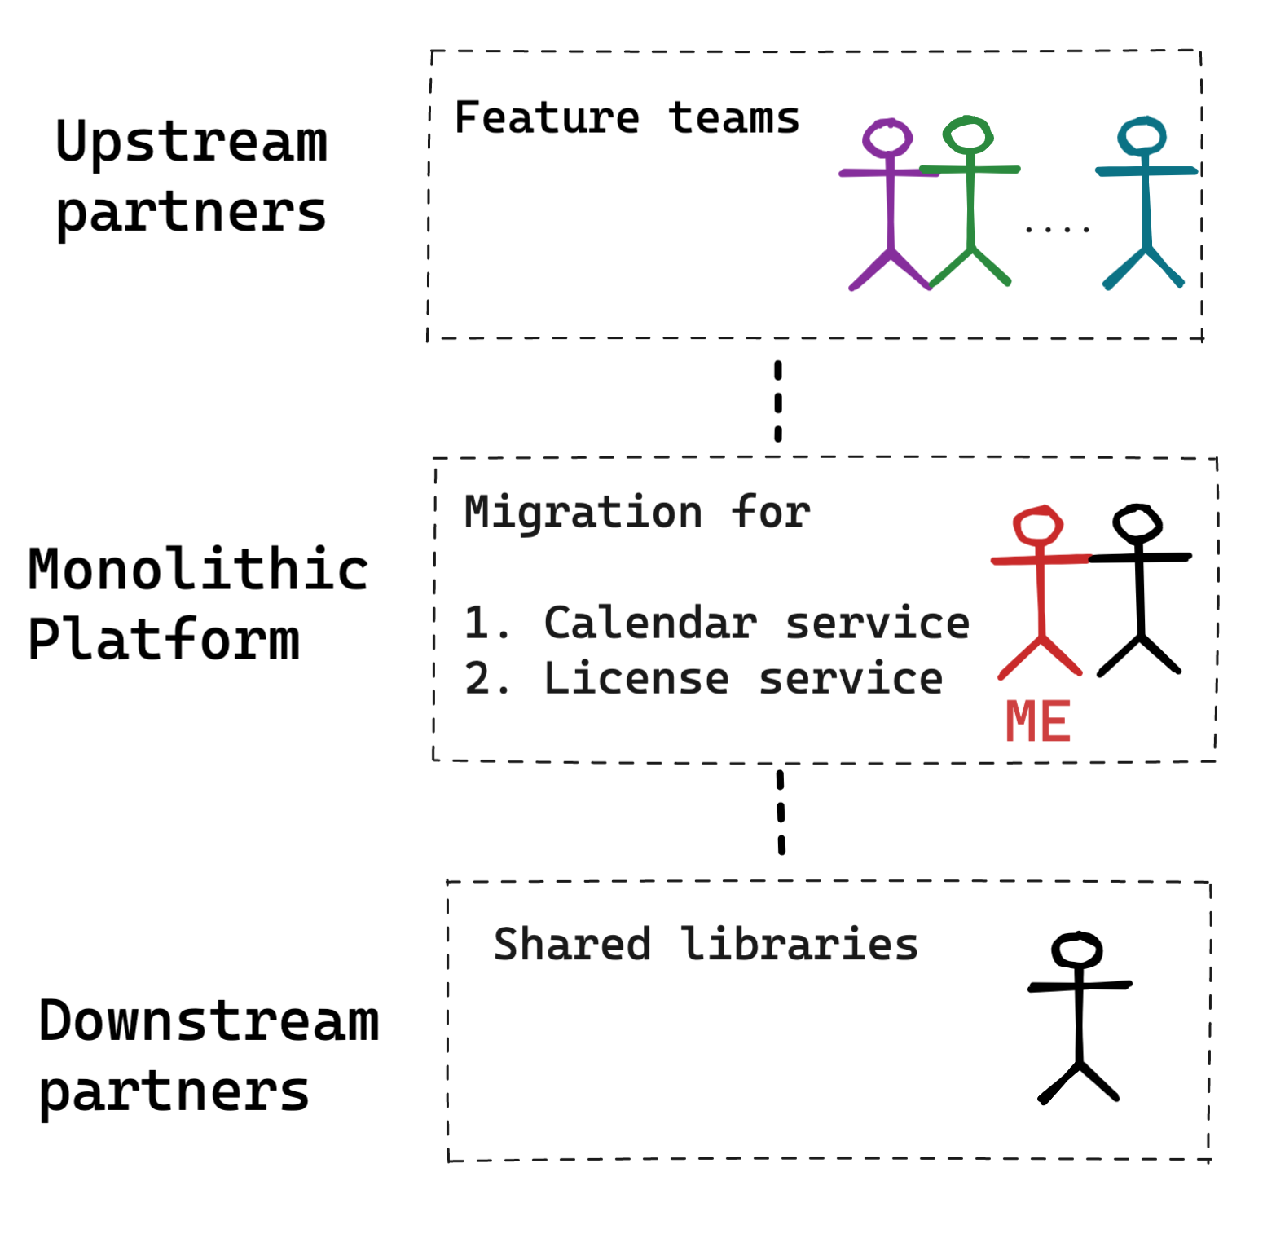
People: Risk management
Has both up/downstream partners

Slide 16
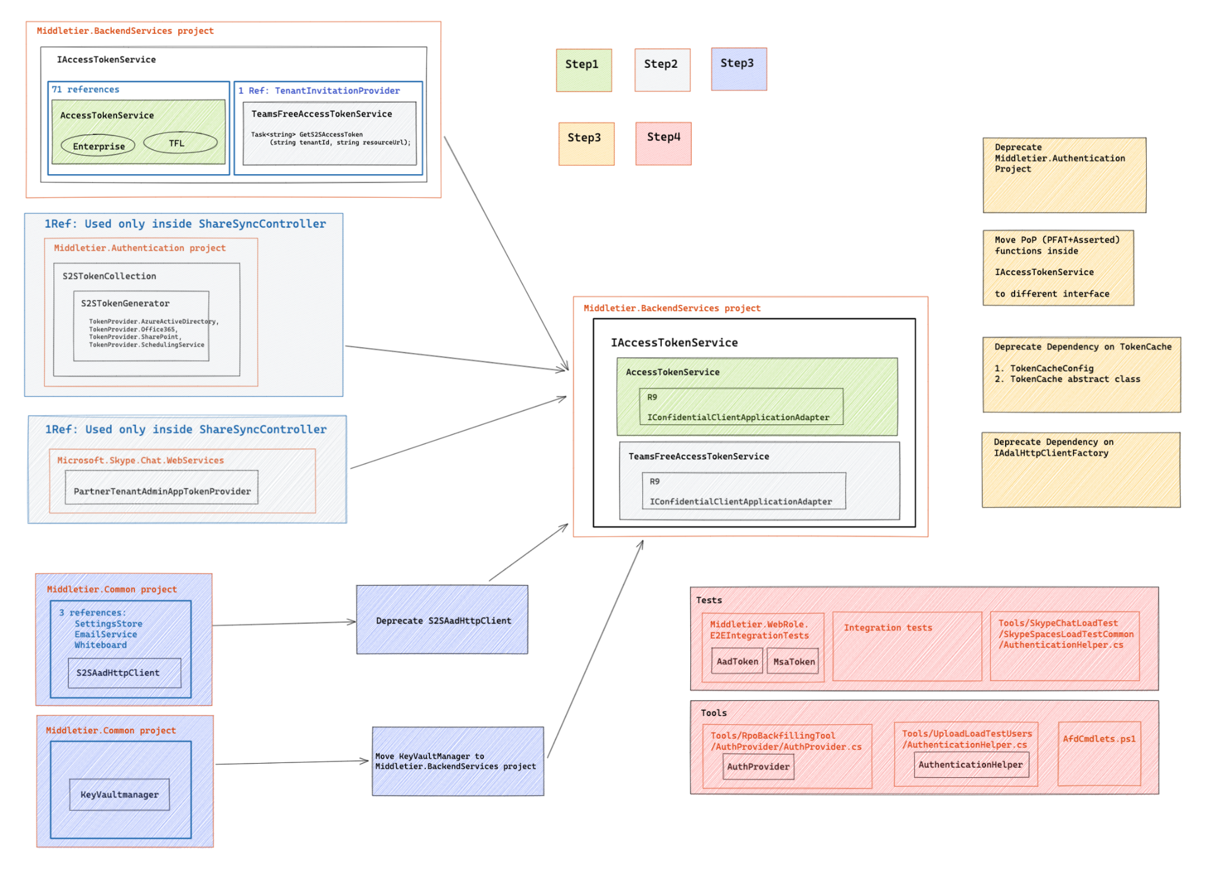
People: Risk management
Upstream partners
Catalog unique auth patterns
Focus on the most widely scenarios first

Slide 17
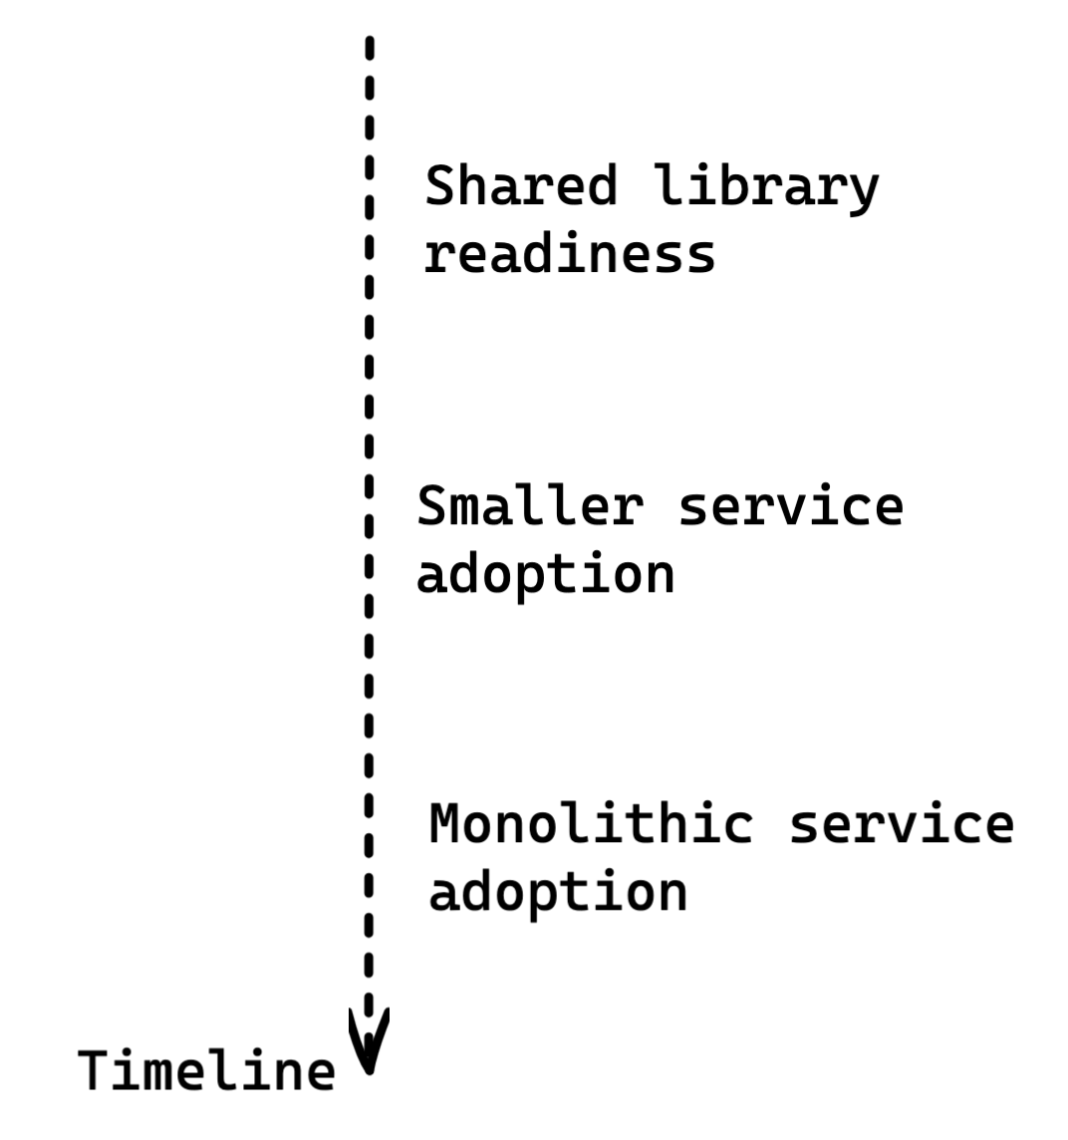
People: Risk management
Downstream partners
Have a system of strategies
Best case, make my task their top priorities
Bringup on calendar (e.g. compliance, etc.)
Lend resources

Slide 18
Outline
Why this migration project?
Background
Motivations
People challenges
Get funding on roadmap
Risk management
Technical challenges
Design shared packages
Debug cache increase issue
Summary

Slide 19
Outline
Why this migration project?
Background
Motivations
People challenges
Get funding on roadmap
Risk management
Technical challenges
Design shared packages
Debug cache increase issue
Summary

Slide 20
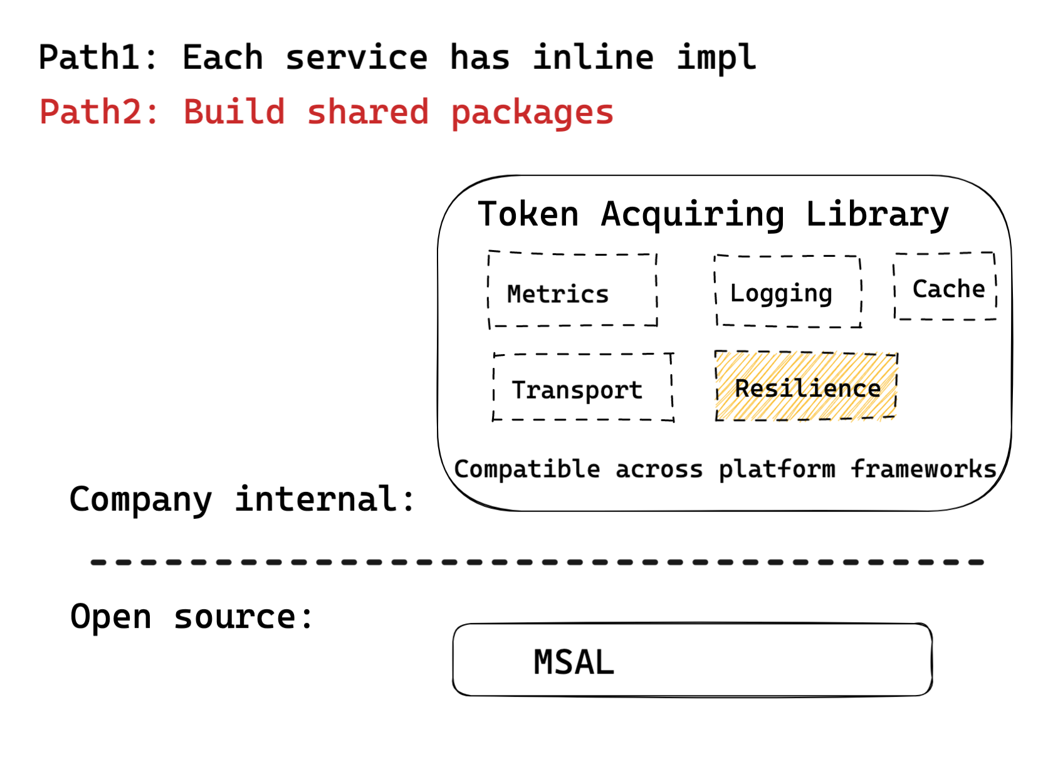
Tech: Design shared libraries for cross-cutting concerns
Design generic libraries

Slide 21
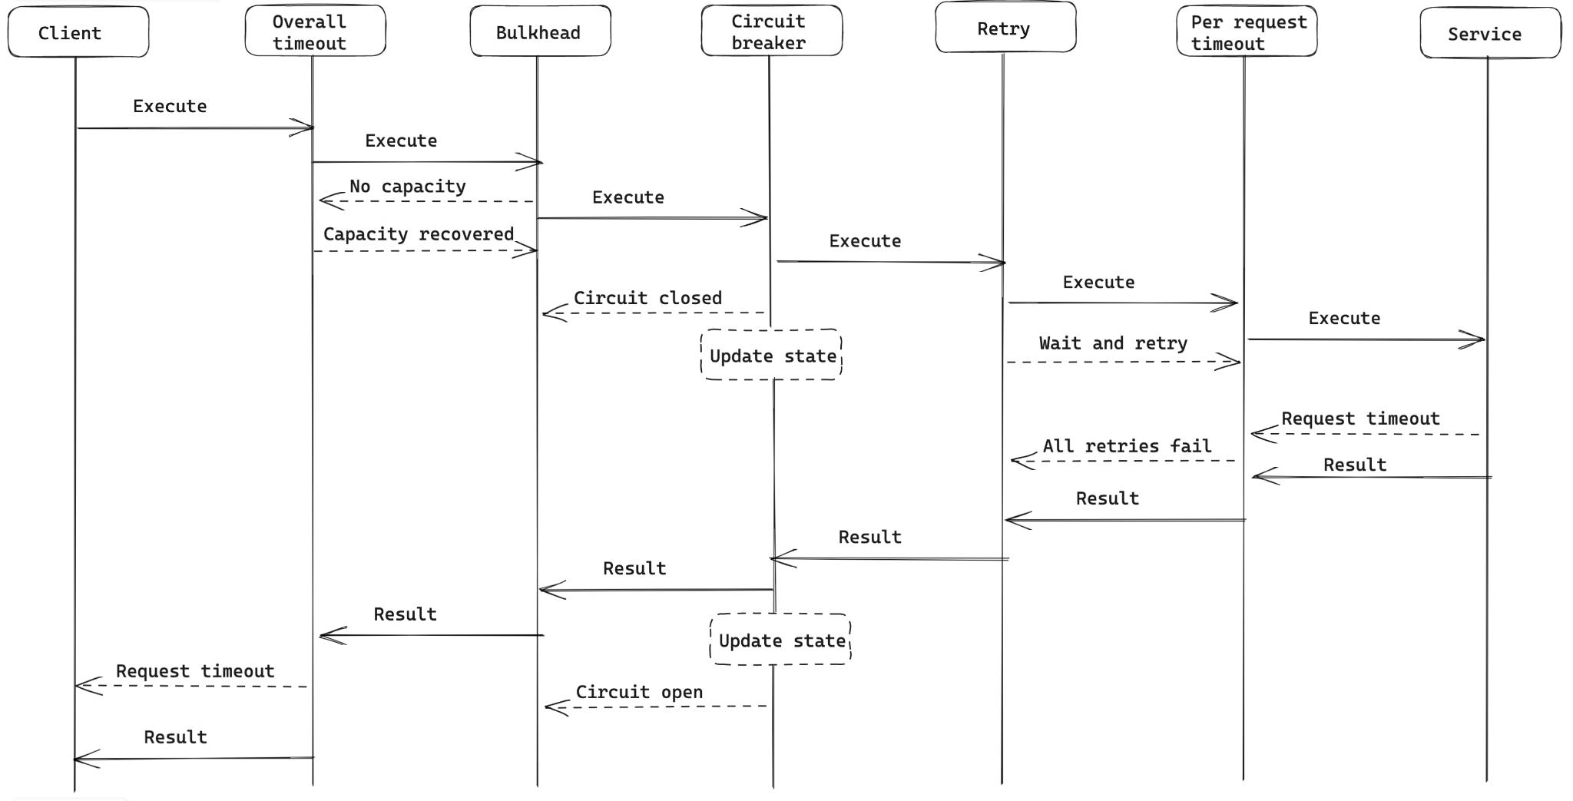
Tech: Resilience in shared package
Resilience
As an exmple

Slide 22
Outline
Why this migration project?
Background
Motivations
People challenges
Get funding on roadmap
Risk management
Technical challenges
Design shared packages
Debug cache increase issue
Summary

Slide 23
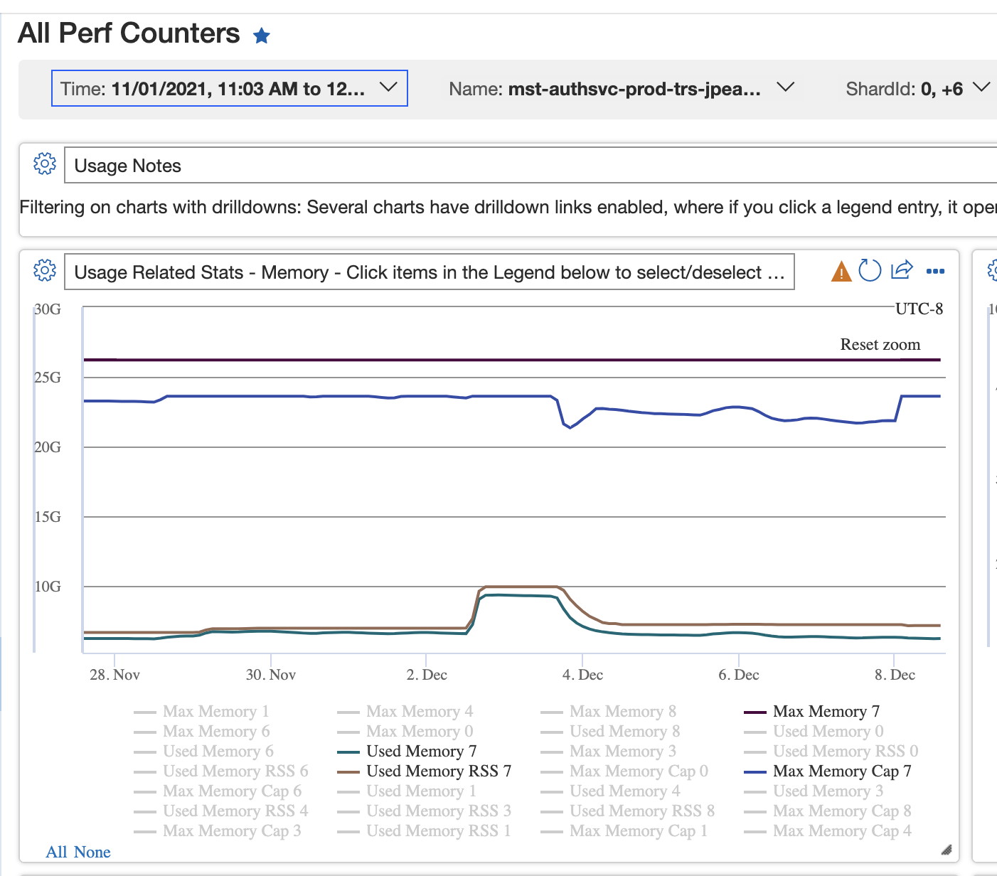
Tech: Debug cache size increase
After deploying the change to first DC, see 1.6 cache size increase

Slide 24
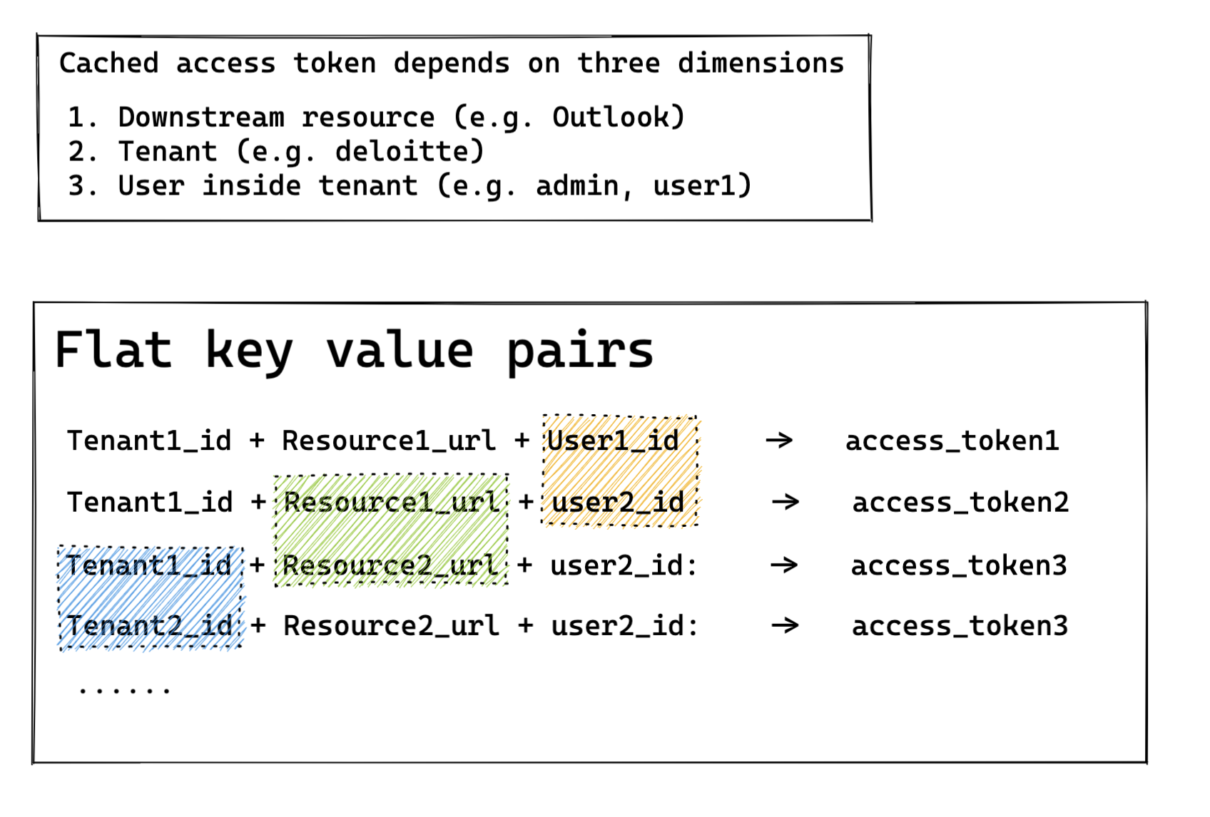
Tech: Debug cache size increase
How entries are stored in Redis

Slide 25
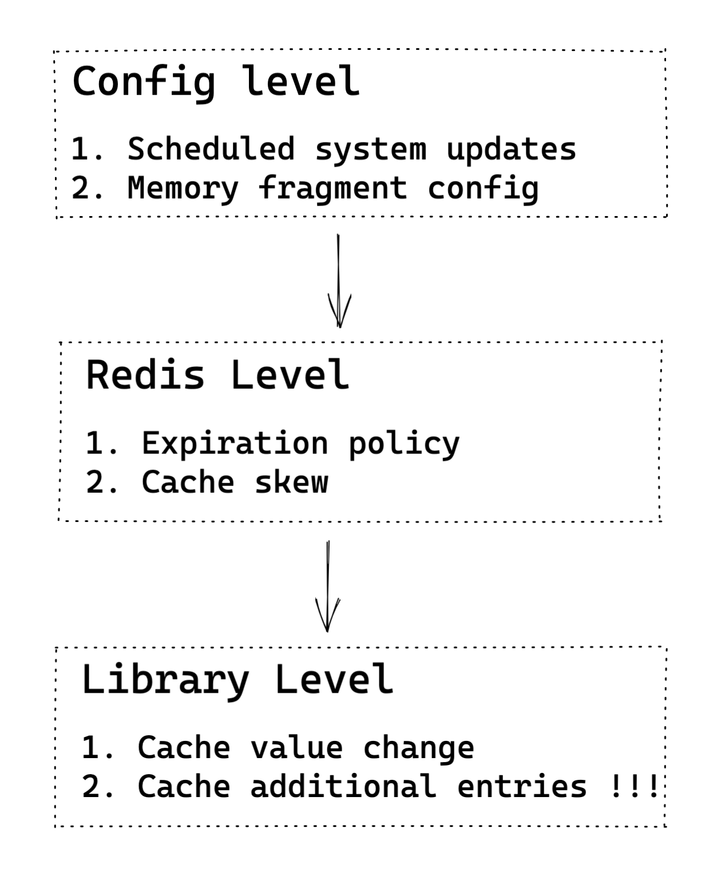
Tech: Debug cache size increase
Root cause is in custom caching layer

Slide 26
Summary
Auth token library migration
Risk management in a large project
Debug Redis real production issues
What I would do differently
Future looking

